Slide 1
BIAS IN MOLECULAR EPIDEMIOLOGY
A story in three parts
Part II
Diagnosing the Observation Process
Public health molecular epidemiology
Justin Bahl
Notes:
Series title: Bias in Molecular Epidemiology: A story in three parts
Part II: Diagnosing the Observation Process

Slide 2
Purpose and learning objectives
How can we identify where surveillance and dataset construction may be shaping the result?
Evaluate genomic coverage using relevant denominators rather than sequence counts alone
Describe the causal and technical mechanisms that determine inclusion
Use planned perturbations to identify sampling-dependent conclusions
Recognize why stability cannot exclude bias shared by every analysis
Part II Diagnosing the Observation Process
2
Notes:
Central question: How can we identify where surveillance and dataset construction may be shaping the result?
Learning objectives:
- Evaluate genomic coverage using relevant denominators rather than sequence counts alone
- Describe the causal and technical mechanisms that determine inclusion
- Use planned perturbations to identify sampling-dependent conclusions
- Recognize why stability cannot exclude bias shared by every analysis

Slide 3
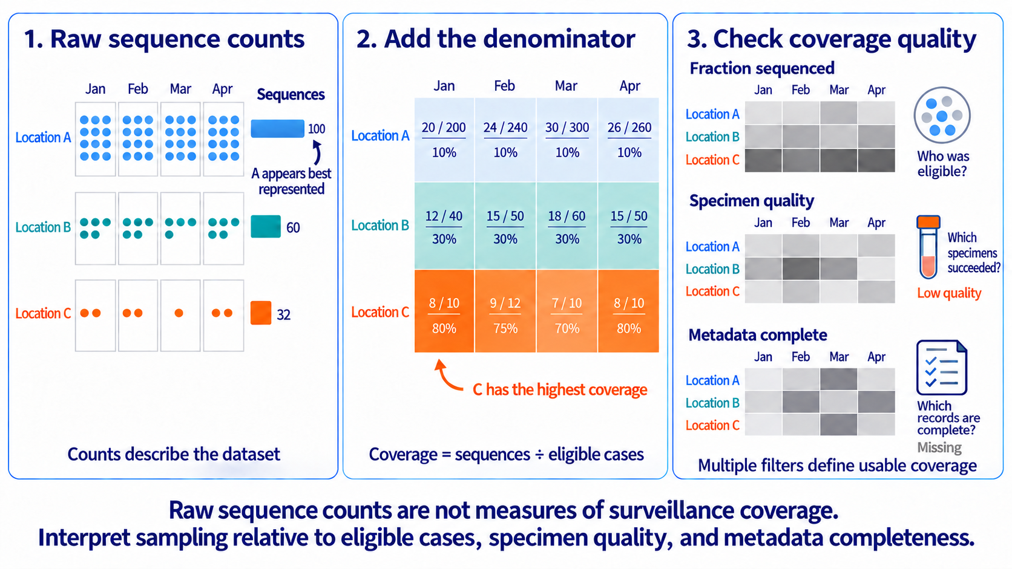
Figure 7
Sampling coverage matrix
Representativeness requires denominators and data-quality information, not raw sequence counts alone.
4
Notes:
Teaching message: Representativeness requires denominators and data-quality information, not raw sequence counts alone.
Panel prompts:
- Raw counts identify where genomes are abundant.
- Cases or another denominator reveal the sequencing fraction.
- Specimen quality and metadata completeness expose additional selection.

Slide 4
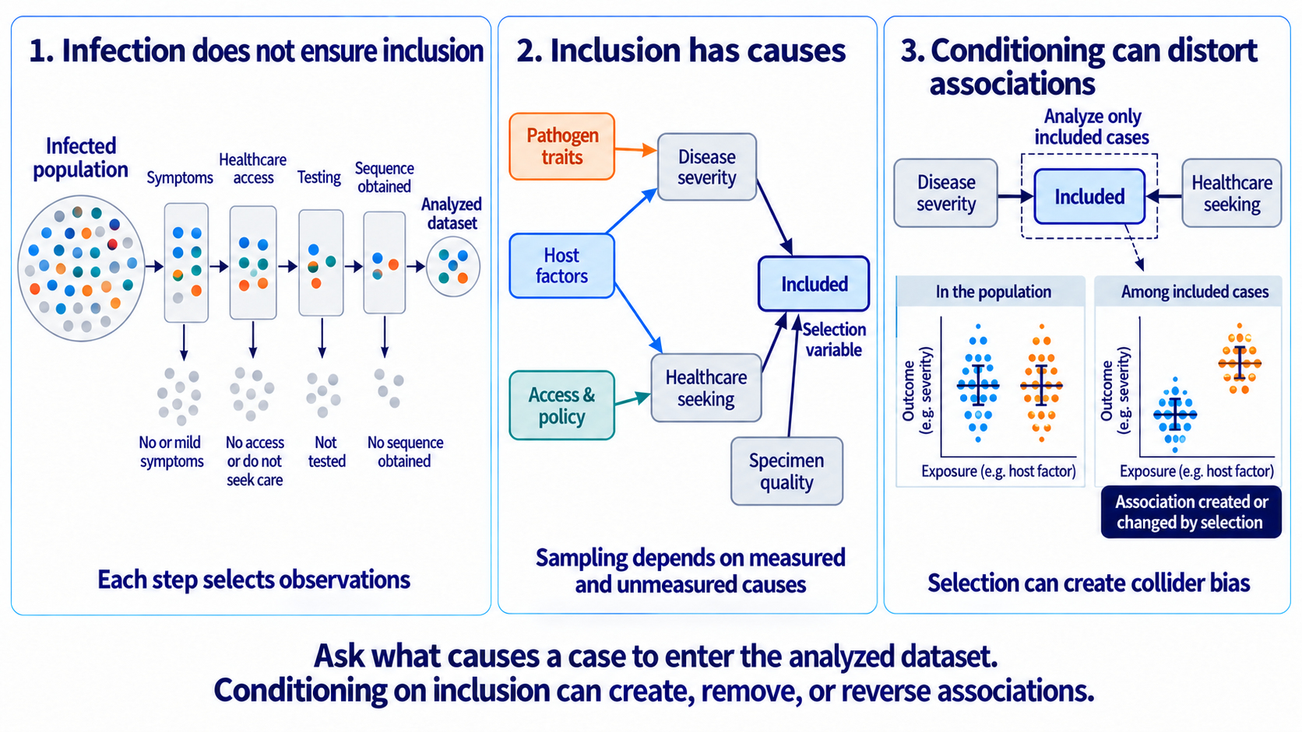
Figure 8
The inclusion mechanism
Selection bias depends on why observations enter the analyzed dataset.
5
Notes:
Teaching message: Selection bias depends on why observations enter the analyzed dataset.
Panel prompts:
- Location, time, host characteristics, and severity can affect inclusion.
- Specimen quality creates a distinct technical path into sequencing.
- Conditioning on inclusion can induce associations.

Slide 5
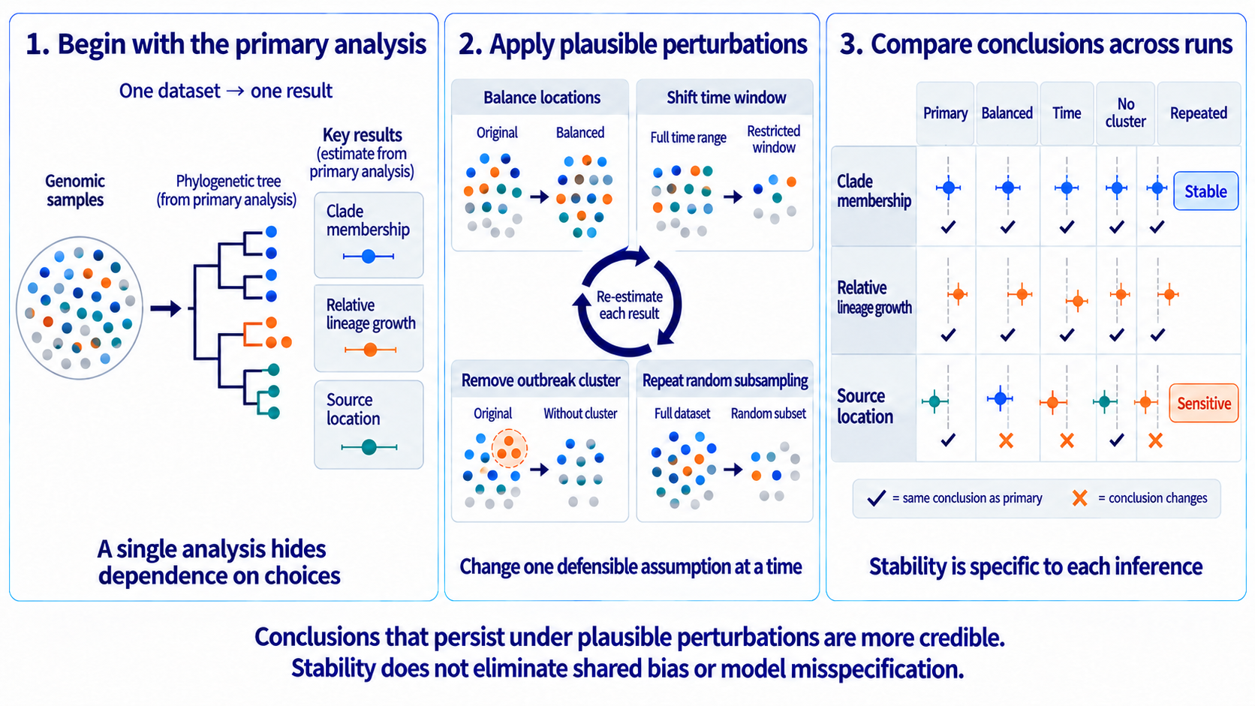
Figure 9
Stability under perturbation
Sensitivity to plausible perturbations identifies conclusions that depend on sampling or analysis choices.
6
Notes:
Teaching message: Sensitivity to plausible perturbations identifies conclusions that depend on sampling or analysis choices.
Panel prompts:
- Perturb geography, time, outbreak inclusion, and other defensible choices.
- Compare clade membership, relative lineage growth, and source attribution.
- Shared bias can remain stable across every rerun.

Slide 6
Key takeaways
Coverage requires an appropriate denominator.
The inclusion mechanism links surveillance operations to inferential bias.
Perturbation identifies dependence on tested choices, not validity under untested assumptions.
Part II Diagnosing the Observation Process
Bias in Molecular Epidemiology: A story in three parts
7
Notes:
Closing takeaways:
- Coverage requires an appropriate denominator.
- The inclusion mechanism links surveillance operations to inferential bias.
- Perturbation identifies dependence on tested choices, not validity under untested assumptions.

